Slide 1
Week09a
✨No Laptop Monday Funday! ✨
🦜🦜🦜
🦜🦜🦜
🦜🦜🦜
directed graph preview
trees
BOTANY WARMUP
what is a tree?
what is a branch?
what is a node?
ADDITIONAL WARMUP
what does binary mean?
what is a binary tree?
what does ternary mean?
[record lecture]

Slide 2
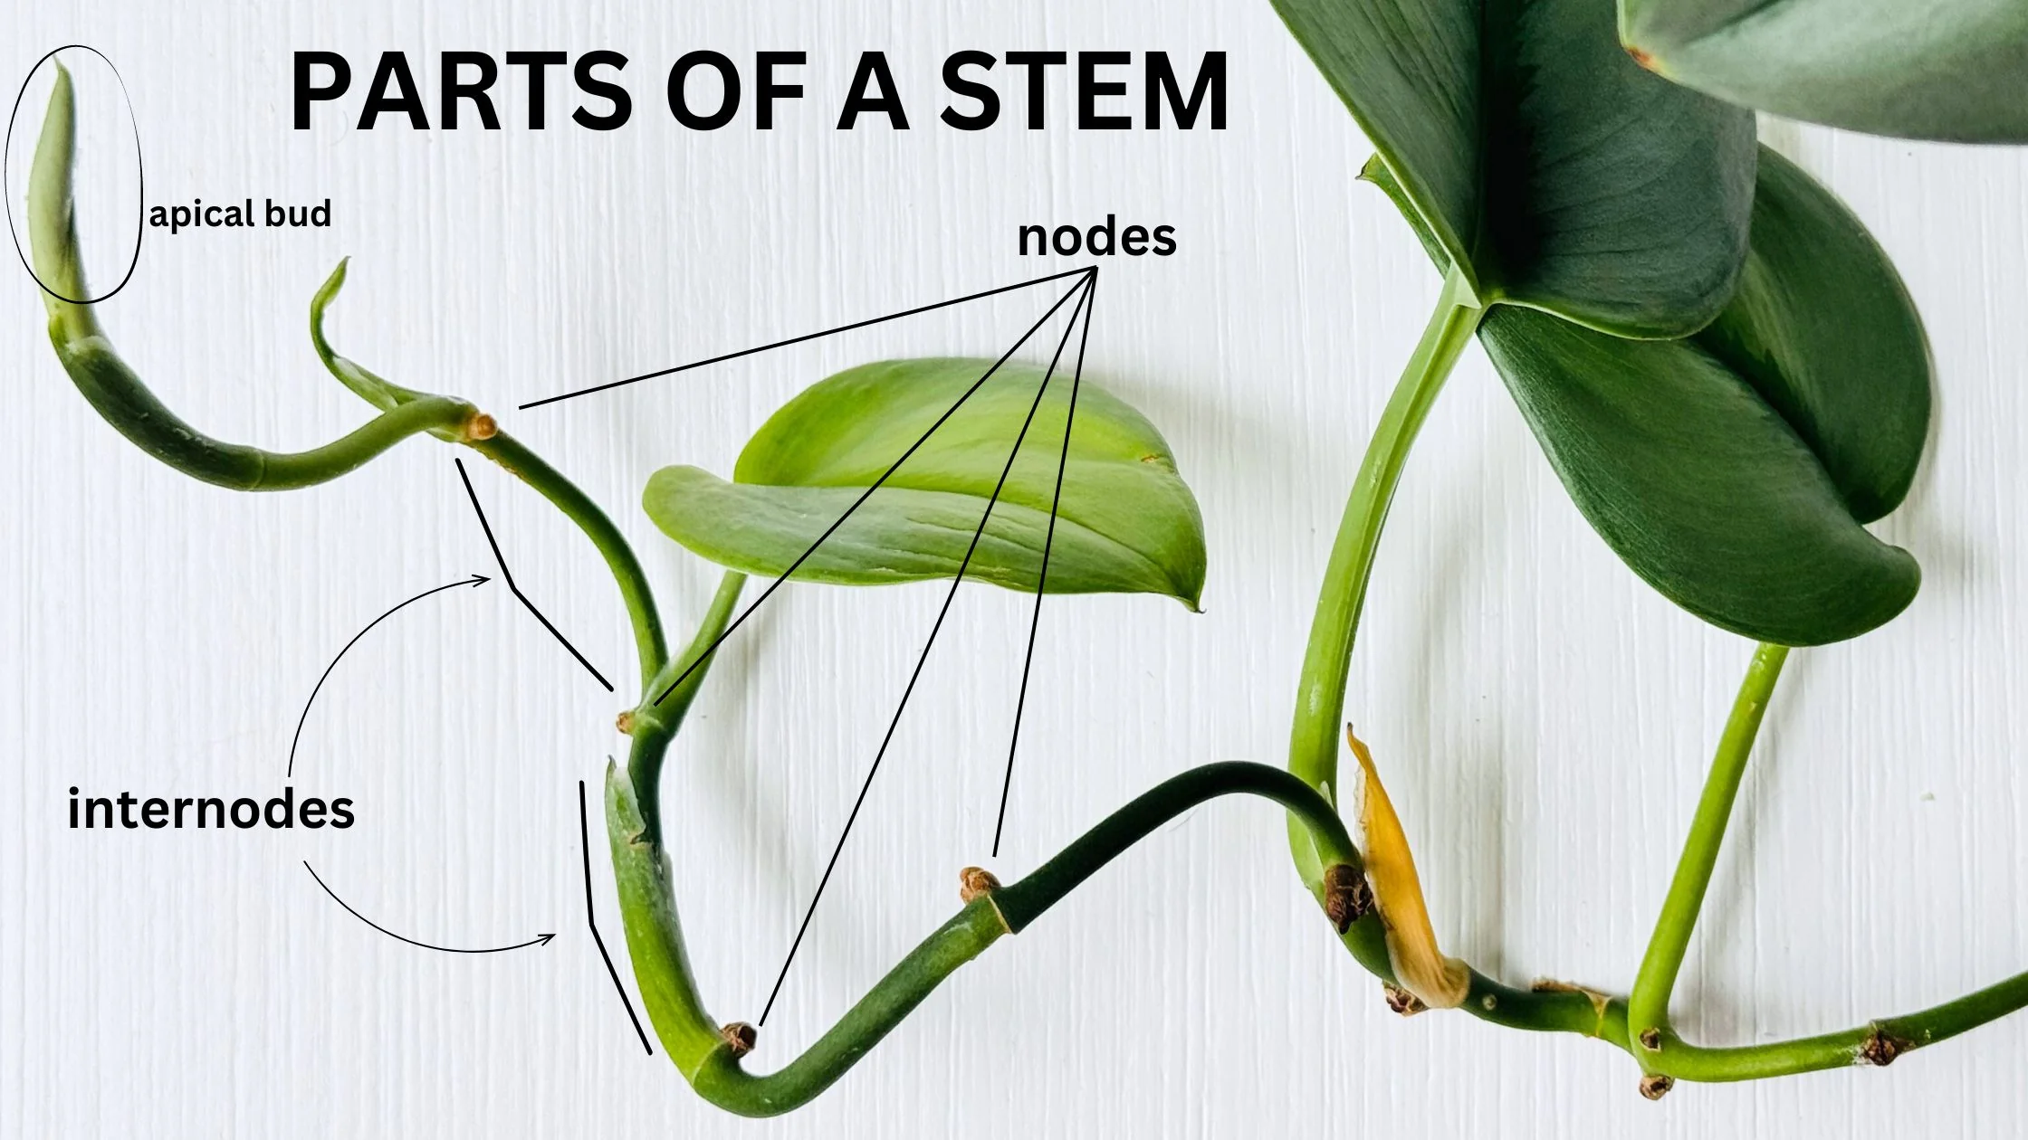

Slide 3
directed graphs

Slide 4
quick note: Math vs. CS

Slide 5
CS vs. Math
a directed graph is a data structure
it has nodes that refer to any number of other nodes
a directed graph G = (V, E) is also a mathematical object
it has vertices (nodes) V
it has directed edges E
note: E is a set of 2-tuples

Slide 6
these are really just two different ways of looking at the same thing

Slide 7
both are useful! (Math to figure out the algorithm, CS to code it up)

Slide 8
in CSCI 136, i will focus on the CS view (MATH 200, CSCI 256 will look at the Math side)

Slide 9
🙂👍

Slide 10
directed graph

Slide 11
the directed graph generalizes the linked list
a node in a directed graph has references to any number of other nodes
nodes are drawn as circles
references are drawn as arrows
let's not worry about
whether this is allowed
or whether this is allowed

Slide 12
(whether we allow for self-edges, multiple edges, etc. depends on context)

Slide 13
🙂👍

Slide 14
tree

Slide 15
kinship terminology (parent, child, etc.)

Slide 16
kinship terminology is useful for describing trees
a node has references to other nodes
it is their parent
they are its children

Slide 17
(directed) tree

Slide 18
a (directed) tree is a directed graph that...
has exactly one node with zero parents (the root)
has no nodes with more than one parent
has no cycles (loops) of any kind
is connected (just one tree, not multiple disconnected trees)
(otherwise, it would be a forest)
5
16
2
2
2
13
18
1
4
11
15
19

Slide 19
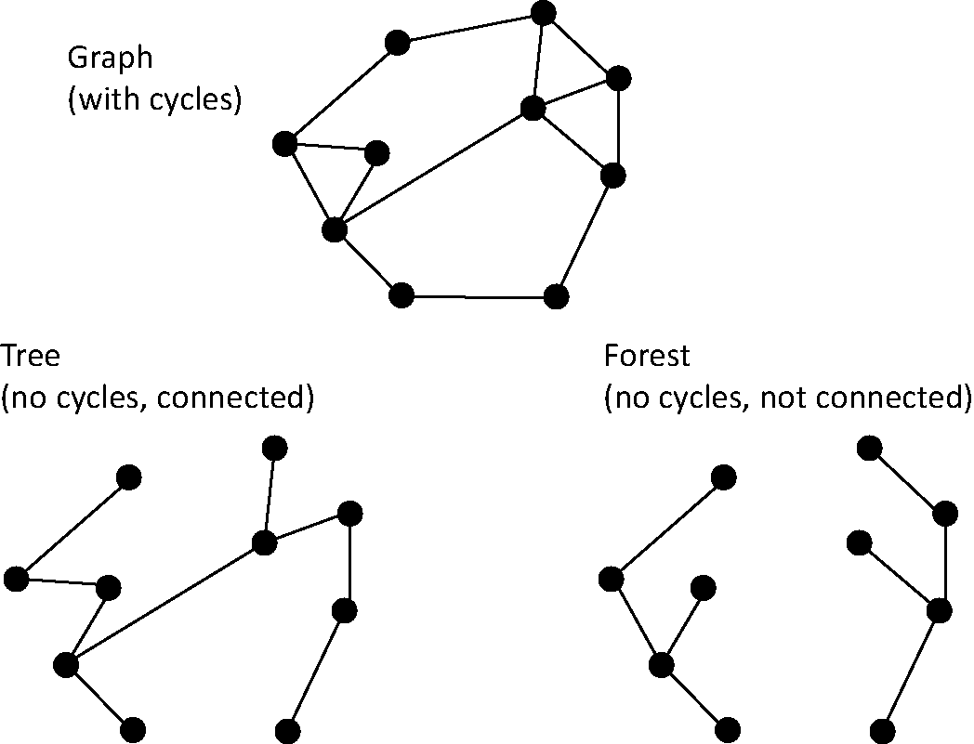
note: not joking

Slide 20
Monday Funday

Slide 21
time for everyone's favorite home game...

Slide 22
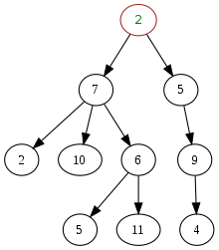
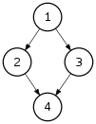
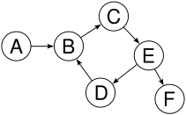
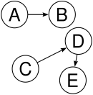

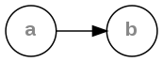
is it a tree?
yes
no
violates 2 & 3
tree rules
exactly one node with zero parents
no node with more than one parent
no cycles
is connected
no
violates 2 & 3
no
violates 1 & 4
no
violates 1 & 3
yes

Slide 23
is it a tree?
yes

Slide 24

can be seen as

Slide 25
uses of trees

Slide 26
simplifying expressions

Slide 27
(2 + 3)
* 4
*
+
4
2
3

Slide 28
5
* 4
*
5
4

Slide 29
20
20

Slide 30
!
(true && )
(false || true)
!
&&
true
||
false
true

Slide 31
!
(true && true)
!
&&
true
true

Slide 32
!true
!
true

Slide 33
false
false

Slide 34
and so much more!

Slide 35
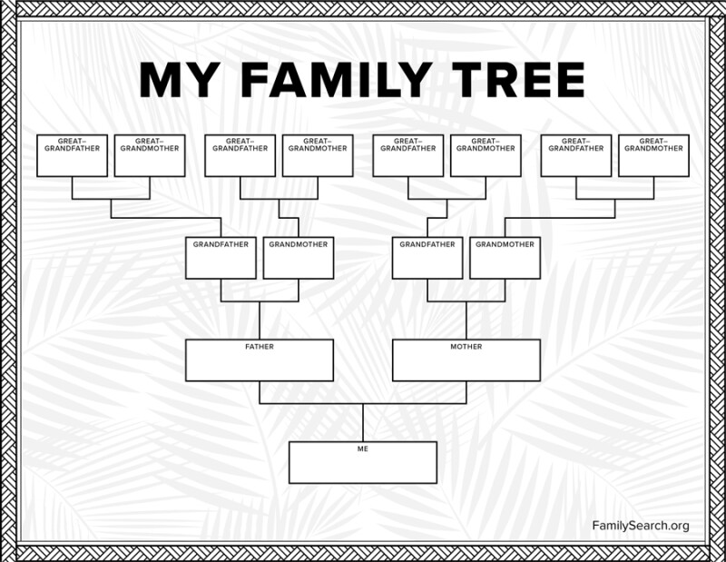

Slide 36
careful: these nodes are
the children of
the node with value jim
jim
jim's mom
jim's dad
jim's mom's mom
jim's mom's dad
jim's dad's mom
jim's dad's dad

Slide 37
note: family trees considered deeply confusing; let us never talk of them again 🙅

Slide 38
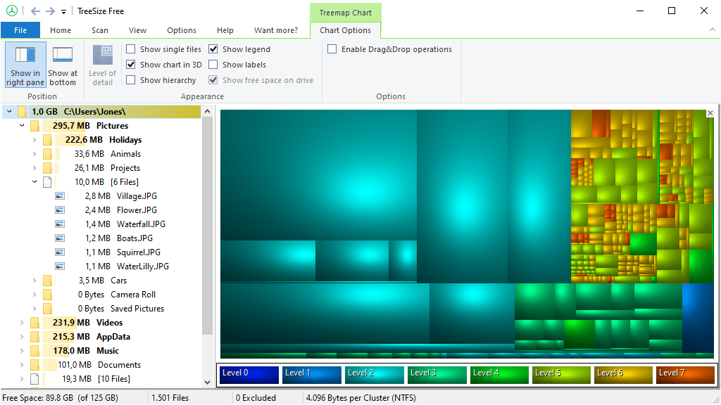
File System (TreeSize Free)
https://www.jam-software.com/treesize_free

Slide 39
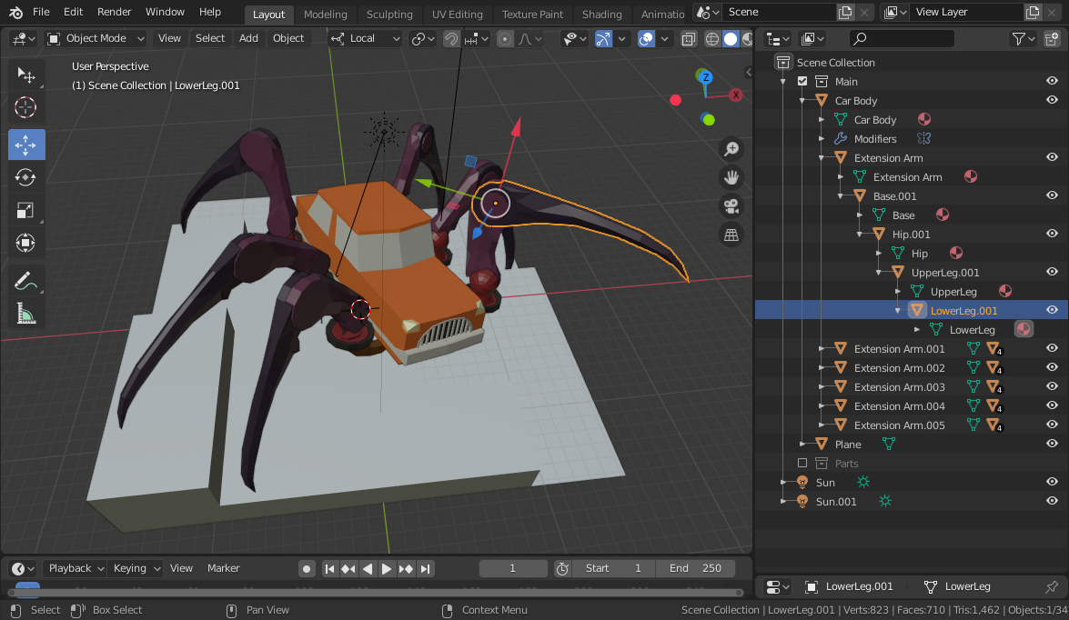
Transformation Hierarchy (Blender)
https://15466.courses.cs.cmu.edu/lesson/hierarchy

Slide 40
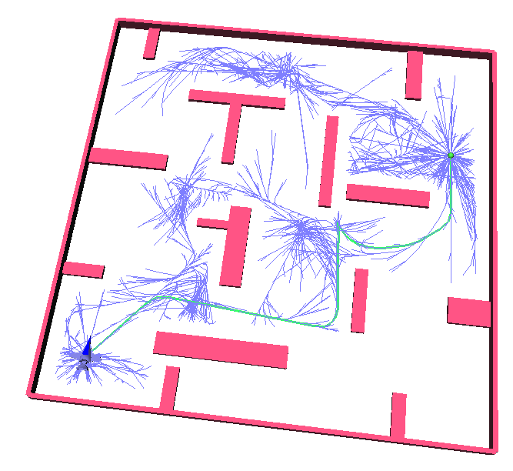
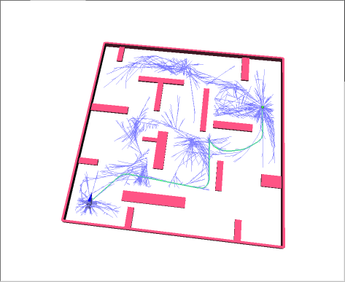
Rapidly Exploring Random Trees (RRTs)
Randomized Kinodynamic Planning by Steven M. LaValle and James J. Kuffner, Jr., International Journal of Robotics Research, 20(5):378--400, May 2001

Slide 41
Hierplane (Mark)

Slide 42
[homework preview]

Slide 43
different ways to implement trees

Slide 44
ArrayList<Node> children; Node leftChild; Node rightChild; Node[] children;

Slide 45
Week09b
✨Laptop Wednesday! ✨
for-each loop
tree terminology
terrific tree traversal tutorial
BONUS WARMUP
evaluate this expression tree
🦜🦜🦜
🦜🦜🦜
🦜🦜🦜
WARMUP
what does depth mean?
what does breadth mean?
what does first mean?

Slide 46
[address the election?]

Slide 47
[record lecture]

Slide 48
☠️ for-each loop

Slide 49
☠️ for-each loop

Slide 50
🐍 Python's for loop is a for-each loop
lst = [ True, 5.0, "Hello" ]
for element in lst: # for each item in the list...
print(element)

Slide 51
a for-each loop can be a convenient alternative to a for loop
for (int turretIndex = 0; turretIndex < turrets.length; ++turretIndex) {
Turret turret = turrets[turretIndex];
...
}
for (Turret turret : turrets) { // for each turret in turrets...
...
}

Slide 52
a for-each loop can be a convenient alternative to a for loop
for (int strokeIndex = 0; strokeIndex < currentFrame.size(); ++strokeIndex) {
ArrayList<Point> stroke = currentFrame.get(strokeIndex);
for (int pointIndex = 0; pointIndex < stroke.size(); ++pointIndex) {
Point point = stroke.get(pointIndex);
...
}
}
for (ArrayList<Point> stroke : currentFrame) {
for (Point point : stroke) {
...
}
}
forgive me 🥲
i swear all that indexing built character

Slide 53
for-each can be convenient but...

Slide 54
you never *need* a for-each loop (some languages don't even have one)

Slide 55
☠️ for-each loops can get you into trouble if you don't fully understand how references and Objects work in Java

Slide 56
☠️ for-each loop dangers
☠ a for-each loop provides a "convenient reference"
☠ LESS powerful than a regular for loop
for (int i = 0; i < things.length; ++i) {
Thing thing = things[i]; // thing is a "convenient reference"
...
}
for (Thing thing : things) { // thing is a "convenient reference"
...
}

Slide 57
☠️ for-each loop dangers
for (int i = 0; i < things.length; ++i) {
things[i] = new Thing(); // does write to array 🙂👍
}
for (int i = 0; i < things.length; ++i) {
Thing thing = things[i]; // thing is a "convenient reference"
thing = new Thing(); // does NOT write to array
}
for (Thing thing : things) { // thing is a "convenient reference"
thing = new Thing(); // does NOT write to array
}

Slide 58
☠️ for-each loop for iterating over a String
in Java, a for-each loop can iterate through String's with toCharArray()
☠ toCharArray() is O(n), but fine for CSCI 136
for (char c : string.toCharArray()) {
...
}

Slide 59
more tree terminology

Slide 60
more tree terminology

Slide 61


Slide 63
the root has no parents a leaf has no children
root
5
16
2
13
18
leaves

Slide 64
a path is a chain of distinct edges
16
path
13
18

Slide 65
a node's depth is the number of edges in the path from the root to that node
depth 0
5
16
depth 1
2
13
18
depth 2
depth 3

Slide 66
level means either depth or (depth + 1) depending on who you ask 🤷‍♀️

Slide 67
tree traversal

Slide 68
breadth-first vs. depth-first

Slide 69


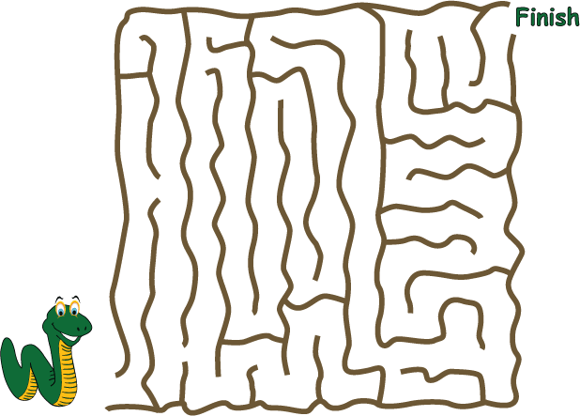
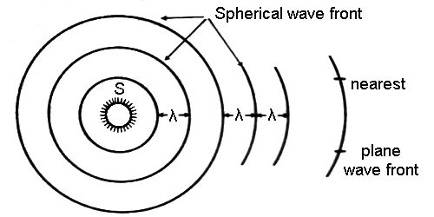
breadth-first vs. (pre-order) depth-first
"a persistent, optimistic, very thorough worm" –Mark Hopkins

Slide 70
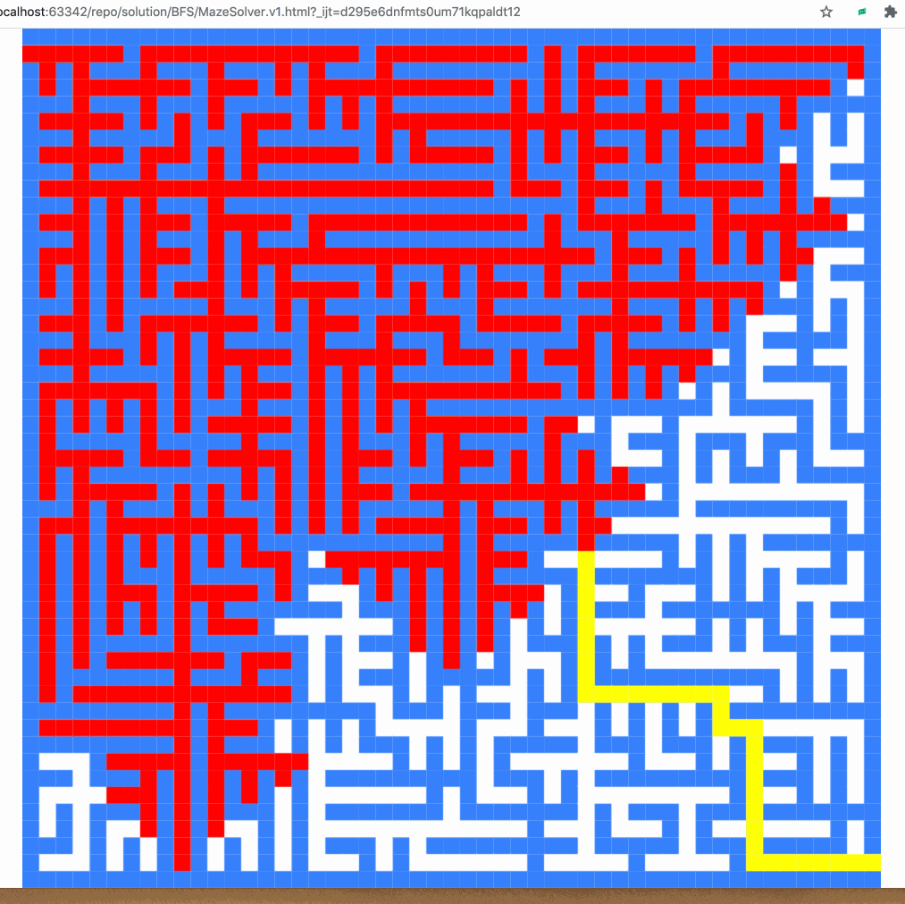
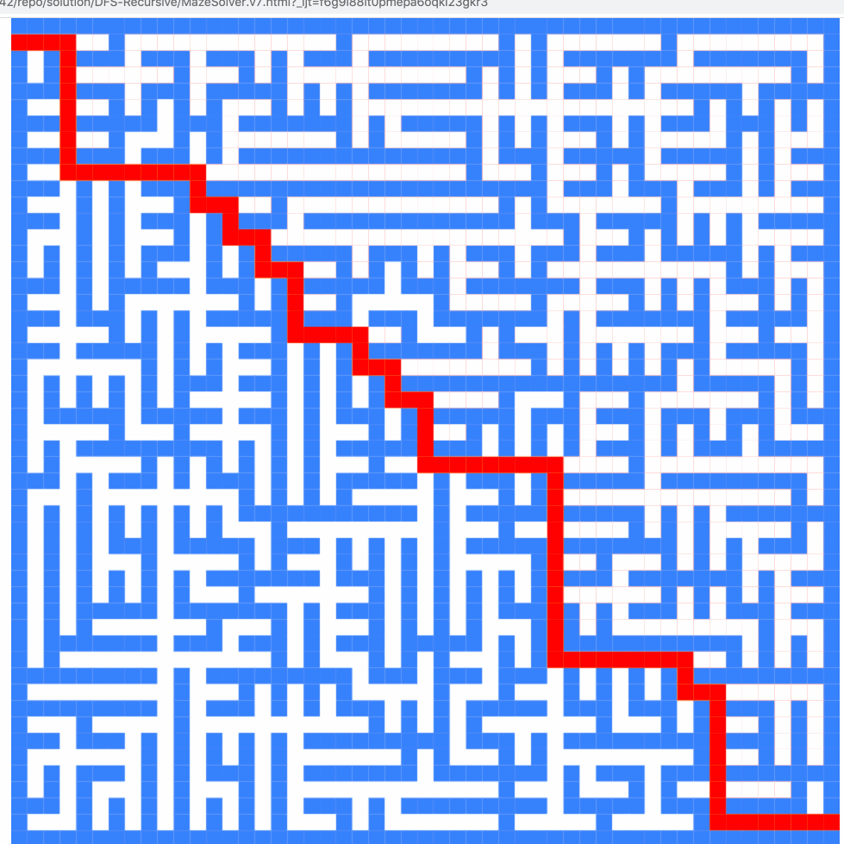
breadth-first vs. (pre-order) depth-first

Slide 71
breadth-first vs. (pre-order) depth-first
0
0
1
2
3
1
2
3
4
5
4
5
6
6
0
1
2
3
4
5
6
0
1
4
6
5
2
3

Slide 72
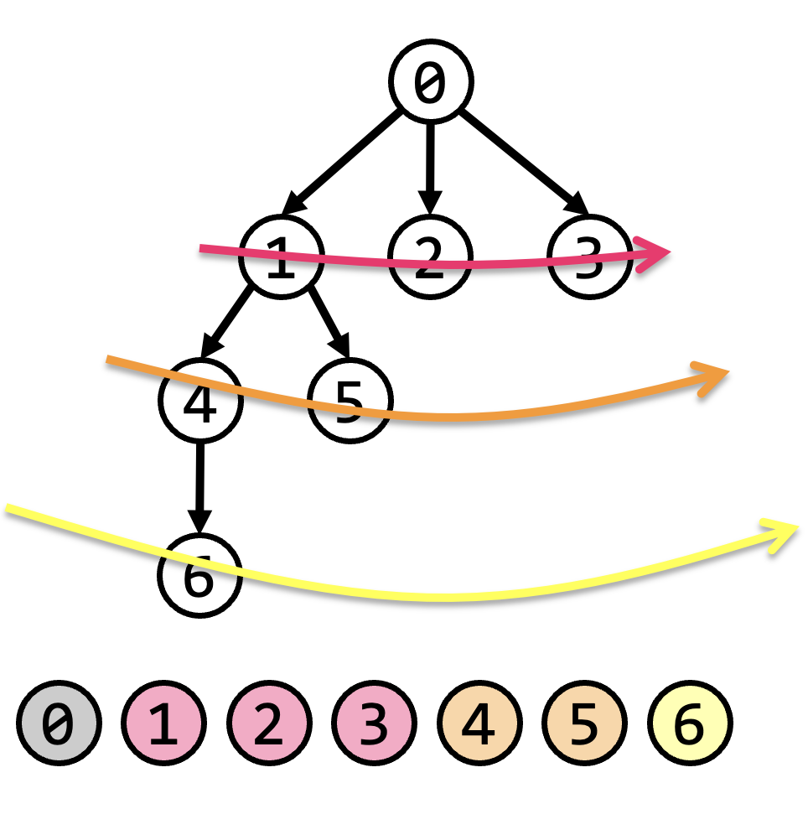
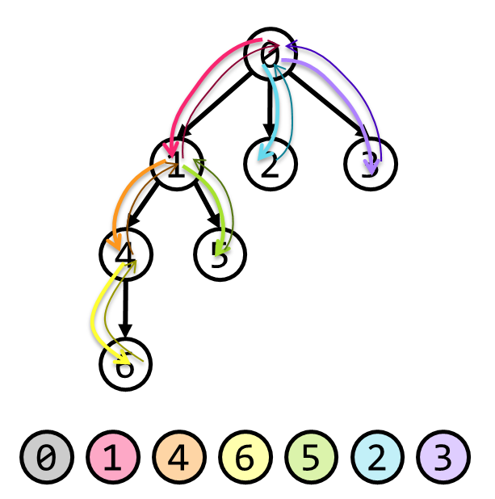
tree traversal (walking the tree)
tree traversal means iterating through all of the tree's nodes
breadth-first first explores as broadly (widely) as possible
one level (depth) at a time
uses a queue
depth-first first explores as deeply as possible
one root-to-leaf path at a time
uses a stack (or recursion, which uses the callstack)
☠ there are actually many different variants of depth-first traversal (i will explain them when we get to binary trees)

Slide 73
why might we want to traverse a tree? why did we want to traverse a linked list? do we ever *traverse* an array?

Slide 74
gathering all words in a trie (HW09)
searching for something (HW10?)
evaluating an expression tree
gathering all the nodes into a list (Tut09)

Slide 75
Terrific Tree Traversal Tutorial

Slide 76
explanation

Slide 77
traverseBreadthFirst
0
0 added to queue
0 removed from queue
1 added to queue
2 added to queue
3 added to queue
1 removed from queue
4 added to queue
5 added to queue
2 removed from queue
3 removed from queue
6 added to queue
4 removed from queue
5 removed from queue
6 removed from queue
7 added to queue
7 removed from queue
1
2
3
4
5
6
queue.add(root)
while queue not empty:
curr = queue.remove()
... # process curr
for child in curr.children:
queue.add(child)
7
0
1
2
3
4
5
6
7

Slide 78
traversePreOrderDepthFirst
change color to indicate
hasBeenVisited = true
start recurse(0)
start recurse(1)
start recurse(4)
finish recurse(4)
start recurse(5)
finish recurse(5)
finish recurse(1)
start recurse(2)
finish recurse(2)
start recurse(3)
start recurse(6)
start recurse(7)
finish recurse(7)
finish recurse(6)
finish recurse(3)
finish recurse(0)
0
1
2
3
4
5
6
def recurse(curr):
... # process curr
for child in curr.children:
recurse(child)
7
recurse(root)
0
1
4
5
2
3
6
7

Slide 79


ANNOUNCEMENTS
today is Fun Friday?
WARMUP vibes seem low, so here is
an extra a-MAZE-ing warmup
draw this maze as a tree
TODAY
tree traversal wrapup; quadtree reading
start
finish

Slide 80
record LEC-02

Slide 81
start
finish

Slide 112
ANNOUNCEMENTS
today is Fun Friday?
WARMUP vibes seem low, so here is
an extra a-MAZE-ing warmup
draw this maze as a tree
TODAY
tree traversal wrapup; quadtree reading
start
finish

Slide 113
worms world party example

Slide 114
tree traversal

Slide 115
breadth-first vs. (pre-order) depth-first
"a persistent, optimistic, very thorough worm" –Mark Hopkins

Slide 116
breadth-first vs. (pre-order) depth-first

Slide 117
breadth-first vs. (pre-order) depth-first
0
0
1
2
3
1
2
3
4
5
4
5
6
6
0
1
2
3
4
5
6
0
1
4
6
5
2
3

Slide 118
(switch slide deck)

Slide 119
Tree Tutorial continued

Slide 120
traverseBreadthFirst
change color to indicate
hasBeenVisited = true
0
0 added to queue
0 removed from queue
1 added to queue
2 added to queue
3 added to queue
1 removed from queue
4 added to queue
5 added to queue
2 removed from queue
3 removed from queue
6 added to queue
4 removed from queue
5 removed from queue
6 removed from queue
7 added to queue
7 removed from queue
1
2
3
4
5
6
queue.add(root)
while queue not empty:
curr = queue.remove()
... # process curr
for child in curr.children:
queue.add(child)
7
0
1
2
3
4
5
6
7

Slide 121
traversePreOrderDepthFirst
change color to indicate
hasBeenVisited = true
start recurse(0)
start recurse(1)
start recurse(4)
finish recurse(4)
start recurse(5)
finish recurse(5)
finish recurse(1)
start recurse(2)
finish recurse(2)
start recurse(3)
start recurse(6)
start recurse(7)
finish recurse(7)
finish recurse(6)
finish recurse(3)
finish recurse(0)
0
1
2
3
4
5
6
def recurse(curr):
... # process curr
for child in curr.children:
recurse(child)
7
recurse(root)
0
1
4
5
2
3
6
7

Slide 122
quadtree rabbit hole 🐰

Slide 123
problem: naive collision detection is slow O(n^2) to check all pairs

Slide 124
idea: use a grid O(n) to assign all circles to grid cells

Slide 125
problem: so many grid cells; most empty!

Slide 126
idea: "only have grid where you need it"

Slide 127
problem: how do we store this?

Slide 128
idea: a tree

Slide 129
idea: a tree

Slide 130
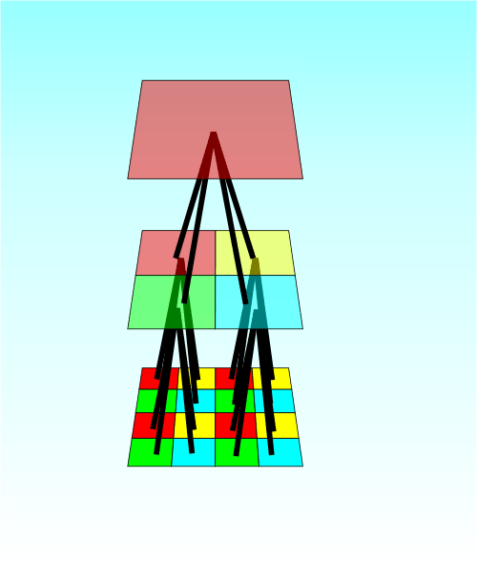

Slide 131
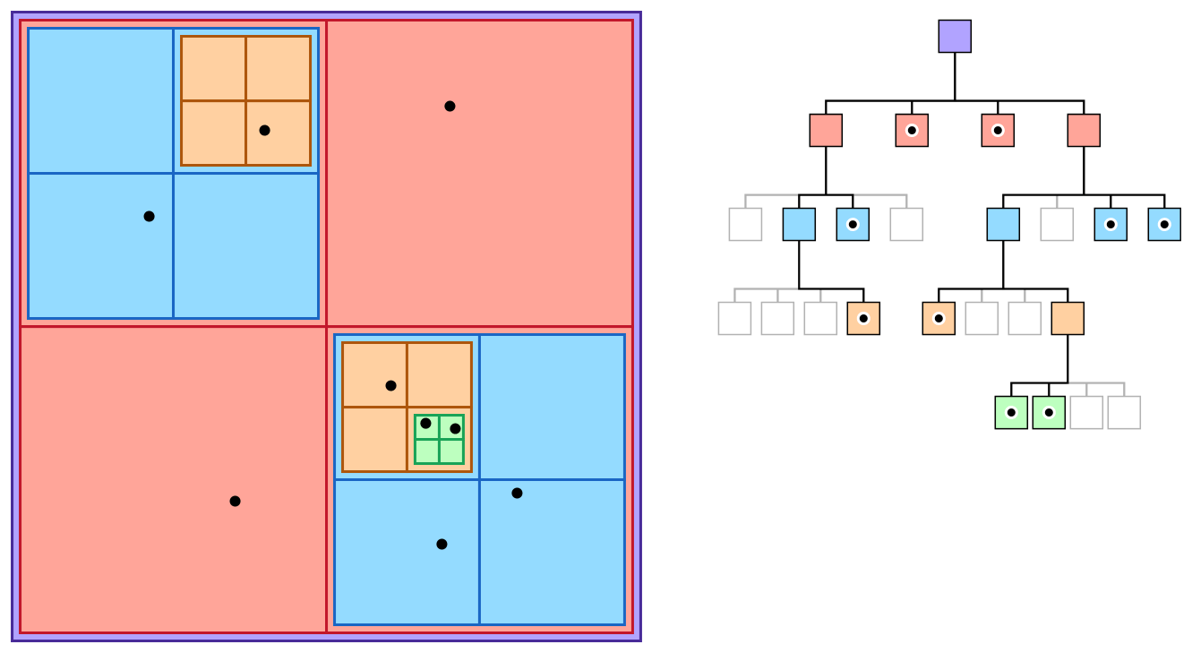

Slide 132
quadtree reading

Slide 133
Week08a
ANNOUNCEMENTS today is No Laptop Monday!
WARMUP "a chain is only as strong as its weakest link"
- what does this expression mean?
- what is a chain?
- what is a link?
- is this true for real-world metal chains? why or why not?
TODAY linked lists
🦜🦜🦜🦜🦜🦜🦜🦜

Slide 134


Slide 135


Slide 136
linked lists
record lecture

Slide 137
(p)review: list interface

Slide 138
list interface
// Get the element with this index.
ElementType get(int index);
// Add (append) an element to the back of the list. void add();
// Add (insert) an element into the list so it has this index void add(int index, ElementType element);
// Remove (delete) the element in the list at this index. void remove(int index);
// Get the number of elements currently in the list. int size();

Slide 139
list interface (cont.)
// NOTE: Many other functions could be included // in this interface.
void sort(); // Sort the list.
void reverse(); // Reverse the list.
List<ElementType> sorted(); // Get sorted copy of the list.
List<ElementType> reversed(); // Get reversed copy of list.
// Get index of first element with this value. int find(ElementType element);
...

Slide 140
a few weeks ago, we implemented the list interface using an array the array list

Slide 141
this week, we will implement the list interface using nodes with "links" (references) to other nodes this will be called a linked list

Slide 142
note

Slide 143
today we will be discussing the simplest possible linked list (LinkedList literally just has a reference to Node head.)

Slide 144
🐍
3.0
head
|
|
head.next
|
|
|
|
|
null

Slide 145
some other implementations are possible. some will be faster than this one.

Slide 146
for linked lists, do NOT memorize big O runtimes out of context

Slide 147
why are we doing this?

Slide 148
A: it will be cool to see two very different implementations of the same interface ☃️

Slide 149
B: linked lists will prepare us for trees and graphs🌳

Slide 150
C: linked lists are incredibly FUNdaMENTAL 🥳 (for us, as fundamental as arrays)

Slide 151
D: linked lists are actually big O better (than array lists) in very specific cases

Slide 152
E: linked lists are actually really, really important (especially in the C programming language)

Slide 153
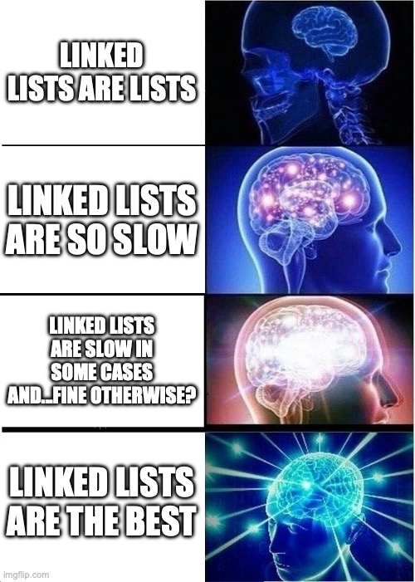

Slide 154
linked list

Slide 156
1.0
2.0
3.0

Slide 157
3.0
1.0
2.0

Slide 158
linked list
LinkedList list = new LinkedList();
class LinkedList {
Node head;
}
list.head = new Node(1.0);
1.0
class Node {
Value value;
Node next;
Node(Value value) {
this.value = value;
}
}
list.head.next = new Node(2.0);
1.0
2.0
list.head.next.next = new Node(3.0);
1.0
2.0
3.0

Slide 159
linked list
LinkedList list = new LinkedList();
class LinkedList {
Node head;
void add(Value value) {
...
}
}
list.add(1.0);
1.0
list.add(2.0);
1.0
2.0
class Node {
Value value;
Node next;
Node(Value value) {
this.value = value;
}
}
list.add(3.0);
1.0
2.0
3.0

Slide 160
example: addFront(value)

Slide 161
addFront(2.0)
value
next
value
next
3.0
4.0 | null
head

Slide 162
addFront(2.0)
3.0
4.0 | null
head

Slide 163
addFront(2.0)
Node tmp = new Node(2.0);
2.0 | null
3.0
4.0 | null
tmp
head

Slide 164
addFront(2.0)
2.0 | null
3.0
4.0 | null
tmp
head

Slide 165
addFront(2.0)
tmp.next = head;
2.0
3.0
4.0 | null
tmp
head

Slide 166
addFront(2.0)
2.0
3.0
4.0 | null
tmp
head

Slide 167
addFront(2.0)
head
head = tmp;
2.0
3.0
4.0 | null
tmp

Slide 168
addFront(2.0)
head
2.0
3.0
4.0 | null
tmp

Slide 169
addFront(2.0)
head
2.0
3.0
4.0 | null
// tmp leaves scope
tmp

Slide 170
addFront(2.0)
head
2.0
3.0
4.0 | null

Slide 171
same thing but with labels instead of arrows for head and tmp

Slide 172
addFront(2.0)
head
3.0
4.0 | null

Slide 173
addFront(2.0)
Node tmp = new Node(2.0);
tmp
head
2.0 | null
3.0
4.0 | null

Slide 174
addFront(2.0)
tmp
head
2.0 | null
3.0
4.0 | null

Slide 175
addFront(2.0)
tmp.next = head;
tmp
head
2.0
3.0
4.0 | null

Slide 176
addFront(2.0)
tmp
head
2.0
3.0
4.0 | null

Slide 177
addFront(2.0)
head = tmp;
head
2.0
3.0
4.0 | null

Slide 178
addFront(2.0)
head
2.0
3.0
4.0 | null

Slide 179
head
2.0
3.0
4.0 | null

Slide 180
2.0
3.0
4.0
(even) more abstract diagram

Slide 181
example: remove

Slide 182
remove
prev
curr
curr.next
3.0
4.0
5.0
Node prev = null; // the previous node
Node curr = head; // the current node
while (...) {
...
prev = curr;
curr = curr.next;
}

Slide 183
remove
prev
curr
curr.next
3.0
4.0
5.0

Slide 184
remove
prev
curr
curr.next
3.0
4.0
5.0

Slide 185
remove
prev.next = curr.next;
prev
curr
curr.next
3.0
4.0
5.0

Slide 186
remove
prev.next = curr.next;
prev
curr
curr.next
3.0
4.0
5.0

Slide 187
remove
prev.next = curr.next;
prev
curr.next
3.0
5.0

Slide 188
remove
3.0
5.0

Slide 189
remove
3.0
5.0

Slide 190
where did the middle node go? - way back when...we created it using new - then we just like..."stopped referring to it" - is it gone now? 😥

Slide 191
🚛it has been garbage collected

Slide 192
[board discussion of "no directed path from stack to the node"]

Slide 193
big O runtimes

Slide 194
what is the big O runtime of size()? [pointing activity]

Slide 195
O(n) 😢

Slide 196
singly-linked list worst case runtimes
head
list.add(index, value)
// O(n)
list.removeByIndex(index)
// O(n)
list.size()
// O(n)
list.addFront() // list.add(0, value)
// O(1)
list.removeFront() // list.removeByIndex(0)
// O(1)
list.addBack()
// O(n)
list.removeBack()
// O(n)

Slide 197
beyond big O runtime

Slide 198

what does this actually look like in memory?
1.0
2.0
3.0

Slide 199
class LinkedList {
Node head;
}
list
LinkedList list = new LinkedList();
list.head = new Node(1.0);
list.head.next = new Node(2.0);
list.head.next.next = new Node(3.0);
0x0a2bcefa
class Node {
double value;
Node next;
}
0x2349d47a3
1.0 0x05287a12
3.0 null
2.0 0xab334b19

Slide 200
1.0 0x05287a12
3.0 null
2.0 0xab334b19

Slide 201
what does this mean? cons? ☹️ pros? 🙂 (how is this very different than an array list?)

Slide 202
https://x.com/_kzr/status/1672497446705037312

Slide 203
class LinkedList {
Node head;
}
List list = new List();
list.head = new Node("Hans");
list.head.next = new Node("The");
list.head.next.next = new Node("Parrot");
list
class Node {
String value;
Node next;
}
0x0a2bcefa
'H' 'a' 'n' 's'
0x2349d47a3
'T' 'h' 'e'
0x234c8b7a 0x05287a12
0x7766231a null
0x3425ff1a 0xab334b19
'P' 'a' 'r' 'r' 'o' 't'

Slide 205
ANNOUNCEMENTS friday's colloquium will be cool!
my friend Pascal makes ✨underwater robotic spheres✨!
midterms will be returned Fri
WARMUP review: for a linked list, size() is O(n) runtime
- how could you make size() (or perhaps... size) O(1)?
-- is this at all...spooky?👻
TODAY size() and riffs on linked lists
Week08b
🦜🦜🦜🦜🦜🦜🦜🦜

Slide 206
🐍
3.0
the front of the snek
head
|
|
head.next
|
|
|
|
the back of the snek
|
null

Slide 207
linked lisssssst

Slide 208
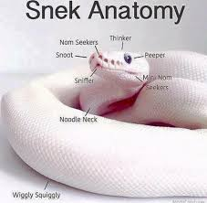

Slide 209
[record lecture]

Slide 210
LinkedList review

Slide 211
runtimes

Slide 212
worst case singly-linked list runtimes
head
list.add(index, value)
// O(n)
list.removeByIndex(index)
// O(n)
list.size()
// O(n)
list.addFront()
// O(1)
list.removeFront()
// O(1)
list.addBack()
// O(n)
list.removeBack()
// O(n)

Slide 213
additional warmup: prepending a list

Slide 214
example
Node snap = new Node(1.0);
Node crackle = new Node(2.0);
Node pop = new Node(3.0);
snap.next = crackle;
crackle.next = pop;
pop.next = head;
head = snap;
✍️
4.0
5.0
head

Slide 215
example
Node snap = new Node(1.0);
Node crackle = new Node(2.0);
Node pop = new Node(3.0);
snap.next = crackle;
crackle.next = pop;
pop.next = head;
head = snap;
4.0
5.0
head

Slide 216
example
Node snap = new Node(1.0);
Node crackle = new Node(2.0);
Node pop = new Node(3.0);
snap.next = crackle;
crackle.next = pop;
pop.next = head;
head = snap;
snap
1.0 | null
4.0
5.0
head

Slide 217
example
Node snap = new Node(1.0);
Node crackle = new Node(2.0);
Node pop = new Node(3.0);
snap.next = crackle;
crackle.next = pop;
pop.next = head;
head = snap;
snap
crackle
1.0 | null
2.0 | null
4.0
5.0
head

Slide 218
example
Node snap = new Node(1.0);
Node crackle = new Node(2.0);
Node pop = new Node(3.0);
snap.next = crackle;
crackle.next = pop;
pop.next = head;
head = snap;
snap
crackle
pop
1.0 | null
2.0 | null
3.0 | null
4.0
5.0
head

Slide 219
example
Node snap = new Node(1.0);
Node crackle = new Node(2.0);
Node pop = new Node(3.0);
snap.next = crackle;
crackle.next = pop;
pop.next = head;
head = snap;
snap
crackle
pop
1.0
2.0 | null
3.0 | null
4.0
5.0
head

Slide 220
example
Node snap = new Node(1.0);
Node crackle = new Node(2.0);
Node pop = new Node(3.0);
snap.next = crackle;
crackle.next = pop;
pop.next = head;
head = snap;
snap
crackle
pop
1.0
2.0
3.0 | null
4.0
5.0
head

Slide 221
example
Node snap = new Node(1.0);
Node crackle = new Node(2.0);
Node pop = new Node(3.0);
snap.next = crackle;
crackle.next = pop;
pop.next = head;
head = snap;
snap
crackle
pop
1.0
2.0
3.0
4.0
5.0
head

Slide 222
example
Node snap = new Node(1.0);
Node crackle = new Node(2.0);
Node pop = new Node(3.0);
snap.next = crackle;
crackle.next = pop;
pop.next = head;
head = snap;
snap
crackle
pop
1.0
2.0
3.0
4.0
5.0
head

Slide 223
example
Node snap = new Node(1.0);
Node crackle = new Node(2.0);
Node pop = new Node(3.0);
snap.next = crackle;
crackle.next = pop;
pop.next = head;
head = snap;
1.0
2.0
3.0
4.0
5.0
head

Slide 224
🧠 was that faster than calling addFront() n times? 🧠 same big O or different big O? (if we were to call it many times)
Node snap = new Node(1.0);
Node crackle = new Node(2.0);
Node pop = new Node(3.0);
snap.next = crackle;
crackle.next = pop;
pop.next = head;
head = snap;
addFront(3.0);
addFront(2.0);
addFront(1.0);
vs.

Slide 225
🧠 was that faster than calling addFront() n times? yes (only updated head once) 🧠 same big O or different big O? same (still have to "hook up" O(n) references)

Slide 226
[implement LinkedList]

Slide 227
[implement LinkedList]

Slide 228
size()

Slide 229
[ implement size() poorly ]

Slide 230
[ implement size() poorly ]

Slide 231
joyful implementation of size

Slide 232
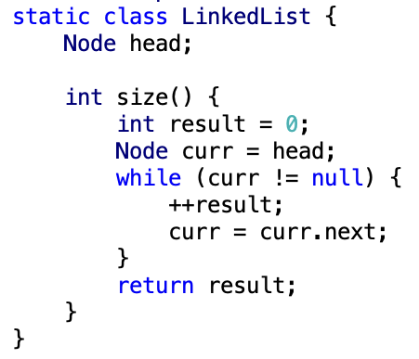

Slide 233
size()
what is the big O runtime of this method?
O(n) ☹️
this seems like a pretty steep cost to pay just to know the list’s size... what would be a more efficient approach?
store size as an instance variable
update it every time you change the number of elements in the list (inside of add, remove, etc.)
what is the runtime of this approach?
O(1) 🙂

Slide 234
while way more efficient, this approach is perhaps a bit spooky 👻 multiple functions are now also responsible for carefully modifying an instance variable (mess up, and any code that depends on size will be very weirdly broken)

Slide 235
note: the A homework doesn't use size at all

Slide 236
but if you were going to implement/use the list's size... i would start with size() as a function, get everything working perfectly, and only then carefully turn it into an instance variable 🙂👍

Slide 237


(it's this thing again)

Slide 238
tail reference

Slide 239
singly-linked list with reference to tail
head
tail
class LinkedList {
Node head;
Node tail;
}
class Node {
Value value;
Node next;
}

Slide 240
singly-linked list with reference to tail worst case runtimes
head
tail
list.add(index, value)
// O(n)
list.removeByIndex(index)
// O(n)
list.size()
// O(n)
list.addFront()
// O(1)
list.removeFront()
// O(1)
list.addBack()
// O(1) 😀
list.removeBack()
// O(n) 😡

Slide 241
doubly-linked list

Slide 242
singly- vs. doubly-linked

Slide 243
singly-linked list
head
class LinkedList {
Node head;
}
class Node {
Value value;
Node next;
}

Slide 244
doubly-linked list
tail
head
class LinkedList2 {
Node2 head;
Node2 tail;
}
class Node2 {
Value value;
Node2 next;
Node2 prev;
}

Slide 245
🤷
3.0
4.0
5.0

Slide 246
3.0
4.0
5.0

Slide 247
runtimes

Slide 248
worst case doubly-linked list runtimes
tail
head
list.add(index, value)
// O(n)
list.removeByIndex(index)
// O(n)
list.size()
// O(n)
list.addFront()
// O(1)
list.removeFront()
// O(1)
list.addBack()
// O(1) 😀
list.removeBack()
// O(1) 😀

Slide 249
a doubly-linked list is a great way to implement a deque (double-ended queue)
O(1) addFront() O(1) removeFront() O(1) addBack() O(1) removeBack()
🧠 could you pull this off with an array list?
no.
addFront() is O(n)
🧠 could you pull this off with an array?
sort of!—the array deque (amortized O(1) add)

Slide 250
Week08c
warmup: have you pre-registered? what classes are you taking?
🦜
underwater robotic spheres!
colloquium today in Wege (TCL123)
@ 2:30pm

Slide 251
pre-reg

Slide 252
237

Slide 253
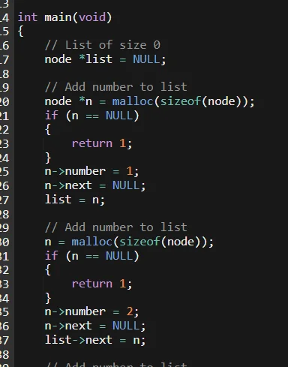

Slide 254
"the stack"
local variable primitives & references to Objects
undefined by default (will NOT compile if used)
"the heap"
the actual Objects (arrays and String's count as Objects)
cleared to 0 or null by default

Slide 256
LinkedList list =
new LinkedList("Hans -> Parrot");

Slide 257
LinkedList list;
{
Node node;
String string;
list = new LinkedList();
node = new Node();
string = "Hans";
node.value = string;
list.head = node;
node = new Node();
string = "Parrot";
node.value = string;
list.head.next = node;
}

Slide 258
LinkedList list;
{
Node node;
String string;
list = new LinkedList();
node = new Node();
string = "Hans";
node.value = string;
list.head = node;
node = new Node();
string = "Parrot";
node.value = string;
list.head.next = node;
}
list
UNDEFINED

Slide 259
LinkedList list;
{
Node node;
String string;
list = new LinkedList();
node = new Node();
string = "Hans";
node.value = string;
list.head = node;
node = new Node();
string = "Parrot";
node.value = string;
list.head.next = node;
}
list
node
UNDEFINED
UNDEFINED

Slide 260
LinkedList list;
{
Node node;
String string;
list = new LinkedList();
node = new Node();
string = "Hans";
node.value = string;
list.head = node;
node = new Node();
string = "Parrot";
node.value = string;
list.head.next = node;
}
list
node
string
UNDEFINED
UNDEFINED
UNDEFINED

Slide 261
LinkedList list;
{
Node node;
String string;
list = new LinkedList();
node = new Node();
string = "Hans";
node.value = string;
list.head = node;
node = new Node();
string = "Parrot";
node.value = string;
list.head.next = node;
}
list
node
string
0x11111111
UNDEFINED
UNDEFINED
null

Slide 262
LinkedList list;
{
Node node;
String string;
list = new LinkedList();
node = new Node();
string = "Hans";
node.value = string;
list.head = node;
node = new Node();
string = "Parrot";
node.value = string;
list.head.next = node;
}
list
node
string
0x11111111
0x22222222
UNDEFINED
null
null null

Slide 263
LinkedList list;
{
Node node;
String string;
list = new LinkedList();
node = new Node();
string = "Hans";
node.value = string;
list.head = node;
node = new Node();
string = "Parrot";
node.value = string;
list.head.next = node;
}
list
node
string
0x11111111
0x22222222
0x88888888
null
null null
H a n s

Slide 264
LinkedList list;
{
Node node;
String string;
list = new LinkedList();
node = new Node();
string = "Hans";
node.value = string;
list.head = node;
node = new Node();
string = "Parrot";
node.value = string;
list.head.next = node;
}
list
node
string
0x11111111
0x22222222
0x88888888
null
0x88888888 null
H a n s

Slide 265
LinkedList list;
{
Node node;
String string;
list = new LinkedList();
node = new Node();
string = "Hans";
node.value = string;
list.head = node;
node = new Node();
string = "Parrot";
node.value = string;
list.head.next = node;
}
list
node
string
0x11111111
0x22222222
0x88888888
0x22222222
0x88888888 null
H a n s

Slide 266
LinkedList list;
{
Node node;
String string;
list = new LinkedList();
node = new Node();
string = "Hans";
node.value = string;
list.head = node;
node = new Node();
string = "Parrot";
node.value = string;
list.head.next = node;
}
list
node
string
0x11111111
0x33333333
0x88888888
0x22222222
0x88888888 null
null null
H a n s

Slide 267
LinkedList list;
{
Node node;
String string;
list = new LinkedList();
node = new Node();
string = "Hans";
node.value = string;
list.head = node;
node = new Node();
string = "Parrot";
node.value = string;
list.head.next = node;
}
list
node
string
0x11111111
0x33333333
0x99999999
0x22222222
0x88888888 null
null null
H a n s
P a r r o t

Slide 268
LinkedList list;
{
Node node;
String string;
list = new LinkedList();
node = new Node();
string = "Hans";
node.value = string;
list.head = node;
node = new Node();
string = "Parrot";
node.value = string;
list.head.next = node;
}
list
node
string
0x11111111
0x33333333
0x99999999
0x22222222
0x88888888 null
0x99999999 null
H a n s
P a r r o t

Slide 269
LinkedList list;
{
Node node;
String string;
list = new LinkedList();
node = new Node();
string = "Hans";
node.value = string;
list.head = node;
node = new Node();
string = "Parrot";
node.value = string;
list.head.next = node;
}
list
node
string
0x11111111
0x33333333
0x99999999
0x22222222
0x88888888 0x33333333
0x99999999 null
H a n s
P a r r o t

Slide 270
LinkedList list;
{
Node node;
String string;
list = new LinkedList();
node = new Node();
string = "Hans";
node.value = string;
list.head = node;
node = new Node();
string = "Parrot";
node.value = string;
list.head.next = node;
}
list
0x11111111
0x22222222
0x88888888 0x33333333
0x99999999 null
H a n s
P a r r o t

Slide 271
LinkedList list;
{
Node node;
String string;
list = new LinkedList();
node = new Node();
string = "Hans";
node.value = string;
list.head = node;
node = new Node();
string = "Parrot";
node.value = string;
list.head.next = node;
}
list
0x11111111
0x22222222
0x88888888 0x33333333
0x99999999 null
H a n s
P a r r o t

Slide 272
memory in C

Slide 273
in C, we often get to choose whether to allocate memory on the stack or the heap

Slide 274
memory allocation
// Java
int[] heapAllocatedArray = new int[10]
heapAllocatedArray[0] = 3;
// C
int stackAllocatedArray[10];
int *heapAllocatedArray = malloc(10000000 * sizeof(int));
stackAllocatedArray[0] = 3;
heapAllocatedArray[0] = 3;
free(heapAllocatedArray);

Slide 275
256

Slide 276
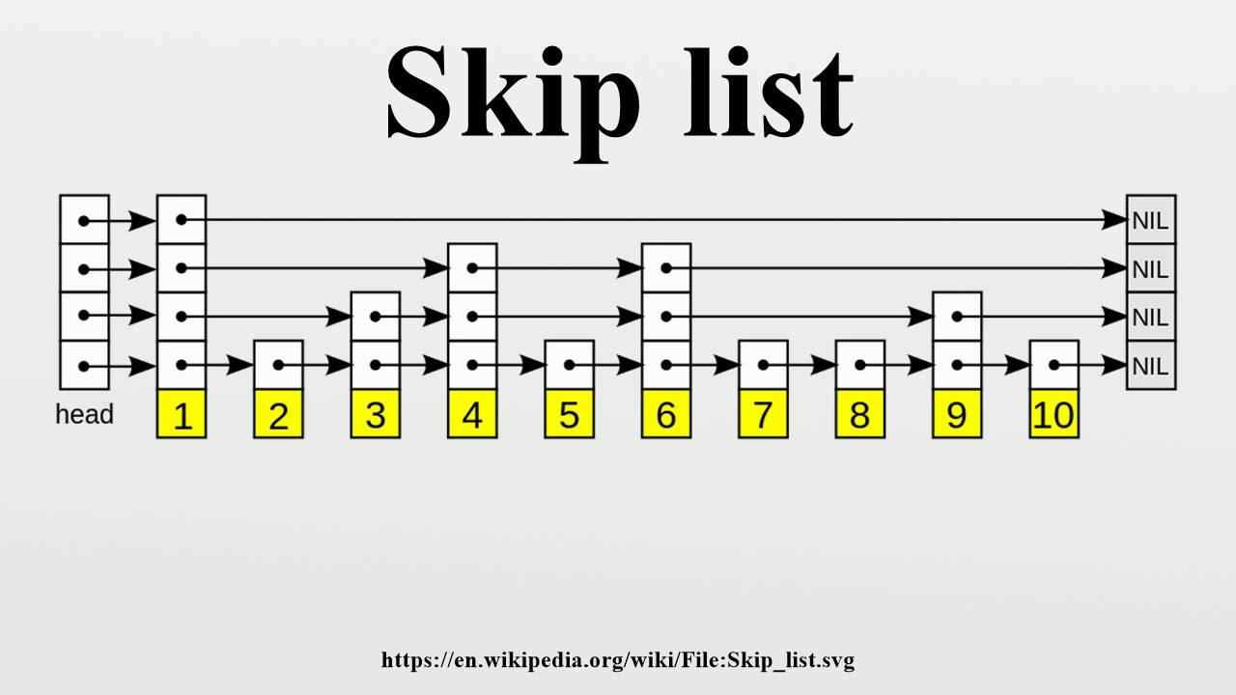

Slide 277
334

Slide 278
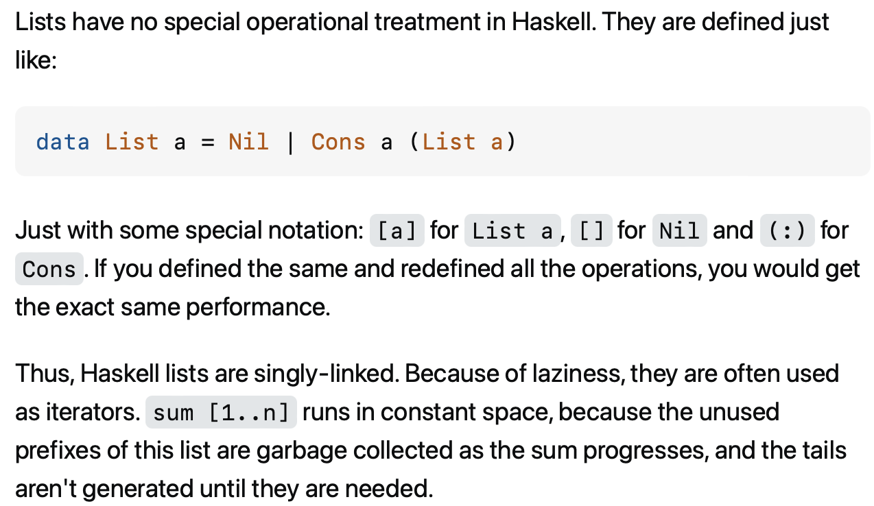

Slide 279
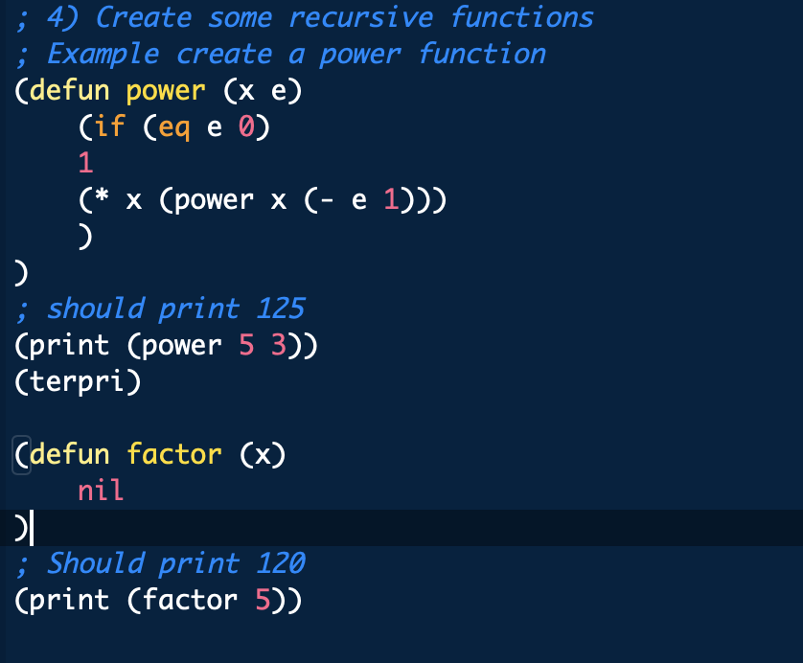

Slide 280
something fun?

Slide 281
fun friday menu - jim rants about comments and syntax highlighting - jim continues codeing (some of) microsoft paint from scratch - jim updates you on his CAD software - jim show and tells about his favorite element - jim reads aloud from grugbrain.dev - jim reads aloud from vim creep - jim reads aloud from hexing the technical interview - jim reads aloud from the truth about lisp - jim reads aloud from the worst API ever made

Slide 282
midterm

Slide 283
common areas of struggle

Slide 284
question 1
syntax
list.add(int 3); // void add(int element);
True
}

Slide 285
}
generally speaking {
you want your curly braces {
}
to look {
something like this {
}
}
}

Slide 286
}
generally speaking
{
you want your curly braces
{
}
to look
{
something like this
{
}
}
}

Slide 287
}
this is quite spooky {
and hard {
to read }
it's hard to tell {
where one scope starts {
and the next ends
}}
do i have enough braces?

Slide 288
question 3
control flow
returning too early (inside for loop)
handling special case too late (after creating array)
if...if vs. if...else if vs. if...else
syntax
list[i]
null
boolean 7Found;
;

Slide 289
question 5
complete understanding of app
pool
single enemy vs. multiple enemies

Slide 290
question 6
complete understanding of app
buffer is 8 characters long, but only length many characters are drawn
last question

Slide 291
results

Slide 292
summay
distribution is very wide (this is normal)
some grades are low (< ~50)
this does not mean you will fail the coure
"if you do all the homework, and the exams just aren't working for you, you will pass CS136" – James Bern, Fri Nov 1
my comments are very sparse
if you don't know why you lost points, or you think i may have made a mistake please ask

Slide 293
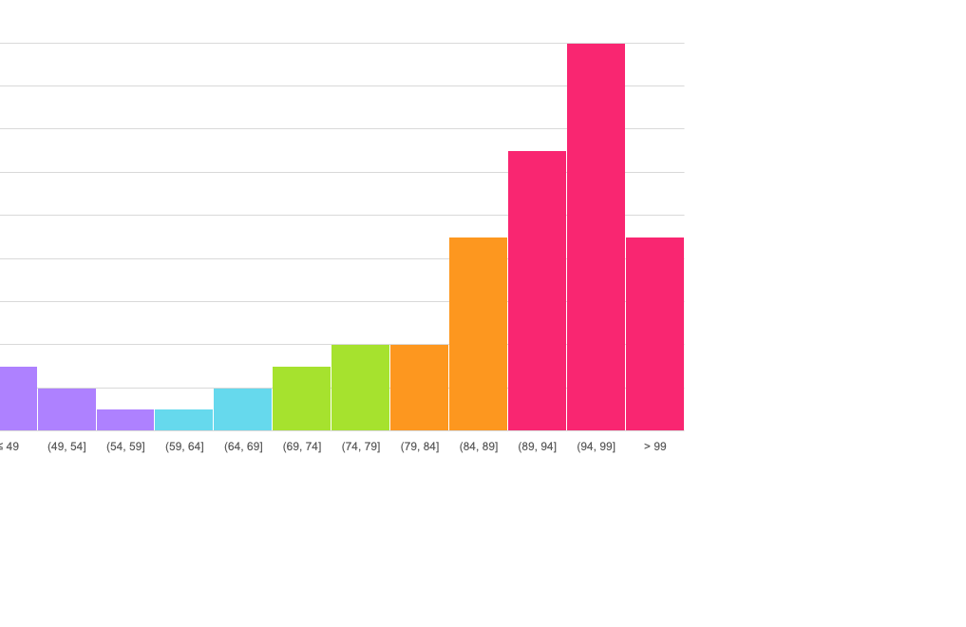
mean: 86.4
standard deviation: 15.9

Slide 294
thoughts

